Slide 1
Web App Overview
Web App Overview

Slide 2
Project Architecture
• Modular component design
• Built with Python framework
• Scalable and maintainable architecture
• Clean separation of concerns

Slide 3
Key Features & Capabilities
• 🚀 RESTful API Design
• 🚀 User Authentication
• 🚀 Database Integration
• 🚀 Scalable Web Architecture

Slide 4
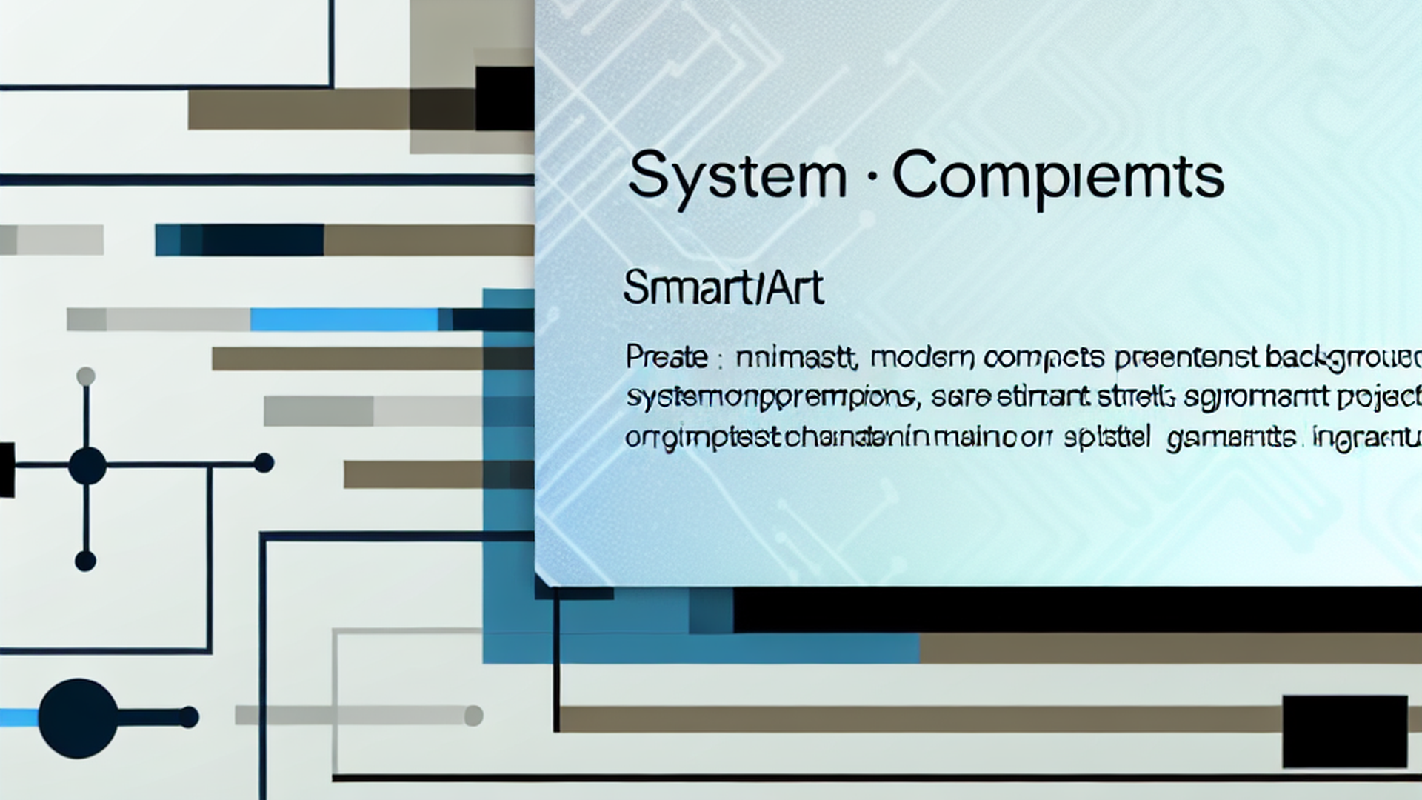
System Components
• RESTful API design
• Data Layer: Storage and persistence
• Frontend Layer: User interface components

Slide 5
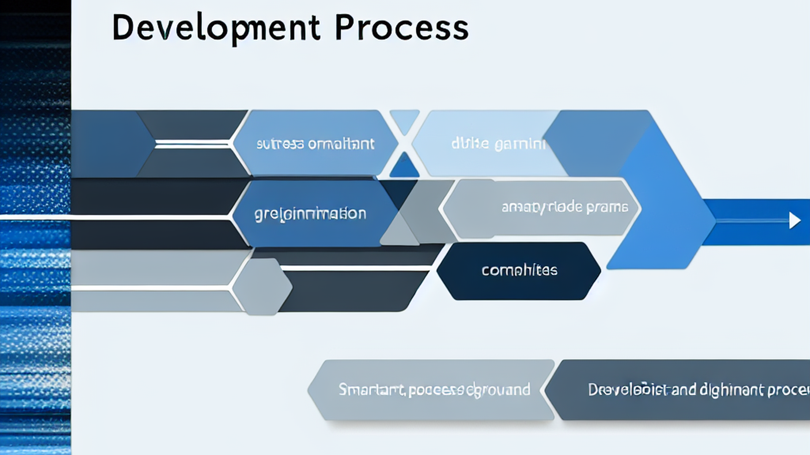
Development Process
• ⚡ React
• ⚡ Python
• ⚡ Vue.js

Slide 6
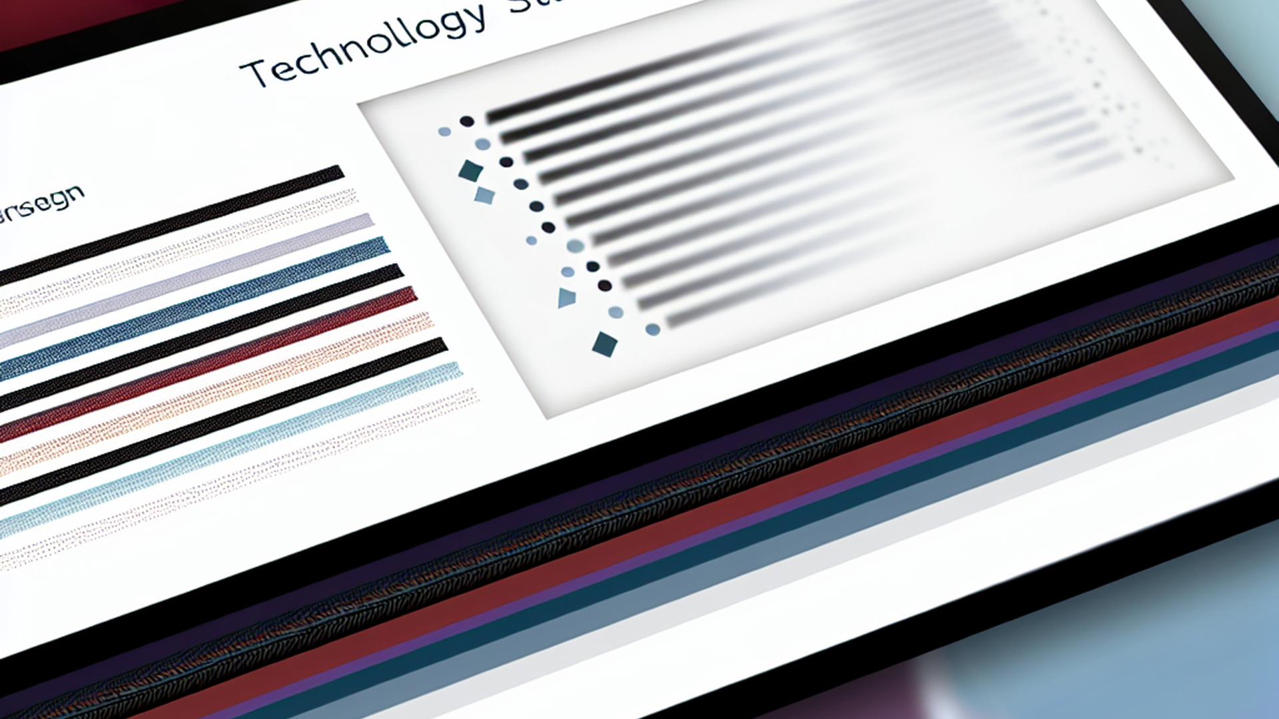
Technology Stack
• ⚡ React
• ⚡ Python
• ⚡ Vue.js

Slide 7
Implementation Highlights
• Code quality assurance
• 📋 Agile development methodology
• 🔒 Security-first implementation
• 🔧 Test-driven development approach

Slide 8
Performance & Scalability
• ⚡ Optimized response times
• Database query optimization
• 📈 Horizontal scaling support
• 🔄 Load balancing implementation

Slide 9
Future Roadmap
• User feedback integration
• 🎯 Feature expansion roadmap
• 🔧 Technology upgrades planned
• 📱 Mobile optimization improvements

